Slide 1
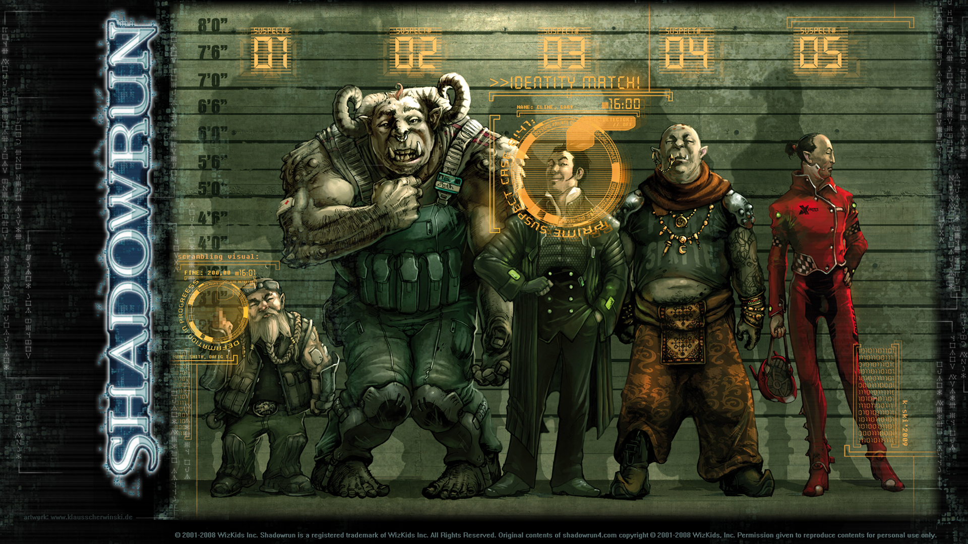
Build-A-Runner Workshop
Character Creation (CRB 58)
Define your role and history (CRB 58)
Roles: Arcane, Face, Street Samurai, Tech
History: Born? Raised? Trained? Now? Lines?
Choose Character Priorities (CRB 63)
(Optional) Select Qualities (CRB 66)
Customize your Character (CRB 66)
Buy Gear (CRB 66)
Finishing Steps (CRB 66)
Contacts
Knowledge and Language Skills
Final Calculations
Other Useful Sections
Condition Monitors (CRB 38)
Edge (CRB 44)
Magic: Spells (CRB 132), Spirits (CRB 147), Adepts (CRB 156)
Matrix: Programs (CRB 184), Actions (CRB 180), Forms (CRB 190), Sprites (CRB 193)
Rigger: Programs (CRB 198, 201), Vehicles & Drones (CRB 295)
Gear: Weapons (CRB 247), Armor (CRB 265), Commlinks (CRB 267), Augmentations (CRB 282)
A Shadowrun: Get the Job (Social; SMG 16), Do the Legwork (Investigation; SMG 19), Run the Op (Tests CRB 35, Combat CRB 104), Profit. [CRB – SR6 Core Rule Book. SMG: Missions Guide v 1.6]

